Slide 1
Python Pandas - Advanced

Slide 2
Agenda
Concatenate Series and Dataframe
Join the Dataframes
Mearge the Dataframes
Stack/Unstack Series and Dataframe
Reshape
Pivot Tables and Cross Tables
Check for Duplicates
Dropping Rows and Columns
Mapping and Replacing
Group the Dataframe
Summary Statistics and Skewness/Kurtosis

Slide 3
Concatenate a Series

Slide 4
Concatenate a series
Creates a new series by appending a series with another series
The concat() and append() methods are used to concatenate a series
One can concatenate more than two series

Slide 5
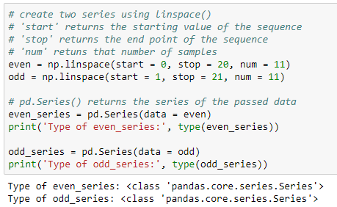
Create a series
Create python series as shown below:

Slide 6
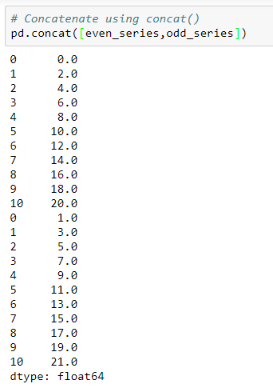
Concatenate a series
The concat() method concatenates a series in the order they are passed in the function

Slide 7
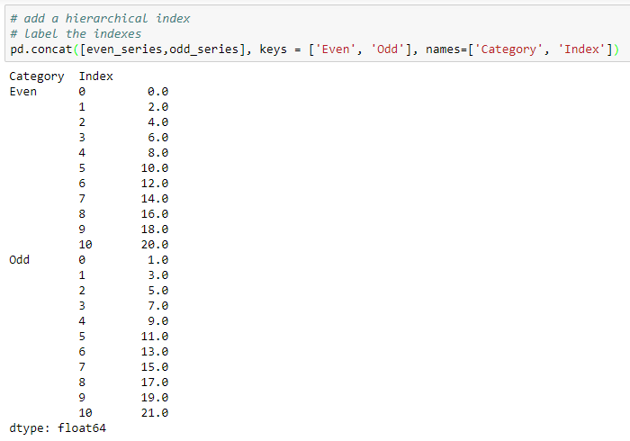
Add hierarchical index and label the index
Add the hierarchical indexes and labels while concatenating two series
Returns the hierarchical indexes
Returns the label of indexes

Slide 8
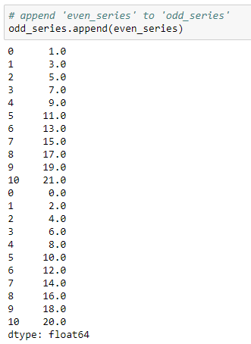
Concatenate a series
The append() method is used append a series with another
Here, we append the ‘even_series’ to ‘odd_series’
Appended indexes are same as the original series

Slide 9
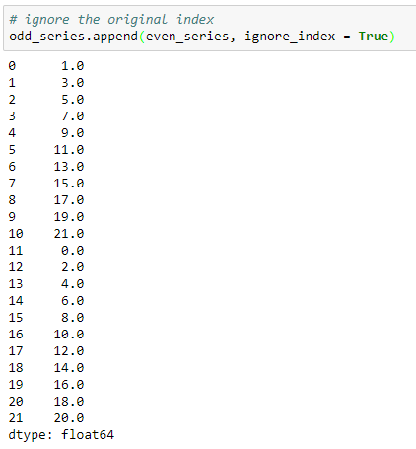
Concatenate a series
Ignores the index labels of original series

Slide 10
Concatenate the DataFrames

Slide 11
Concatenate the DataFrames
A Pandas DataFrame is a two dimensional size-mutable, heterogeneous data structure with labeled rows and columns
DataFrames can be concatenated vertically (column-wise) and horizontally (row-wise)
The concat() and append() methods are used to concatenate the DataFrames

Slide 12
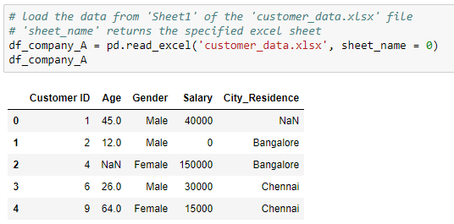
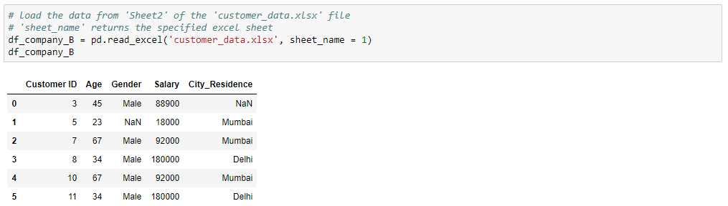
Read the DataFrames
Use these DataFrames for further manipulations:
Customer details of company A
Customer details of company B

Slide 13
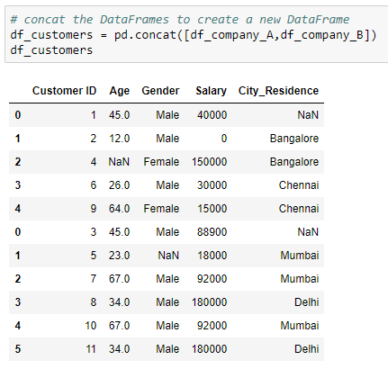
Concatenate the DataFrames
Two DataFrames are concatenated using concat() method
By default, the concat() method concatenates along the axis = 0 (vertically)
The concatenation is in the order they are passed in the function
The index numbers of the concatenated DataFrame are of the actual DataFrames

Slide 14

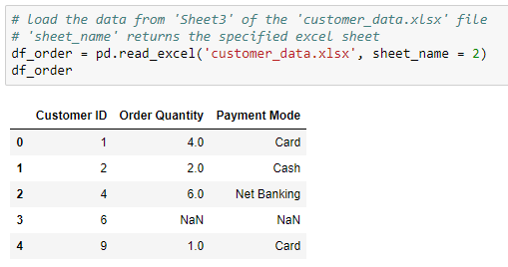
Read the DataFrames
The DataFrames contains order data for customers of company ‘A’. Use these DataFrames for further manipulations:
Customer details
Order details

Slide 15
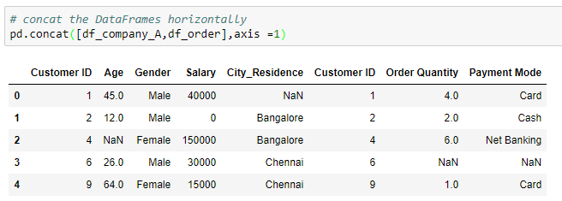
Concatenate the DataFrames
The parameter, ‘axis = 1’ concatenates the DataFrames horizontally
The concatenation is in the order they are passed in the function
As, we do not have the order details for ‘Customer ID = 6’, the NaNs are printed for corresponding columns

Slide 16
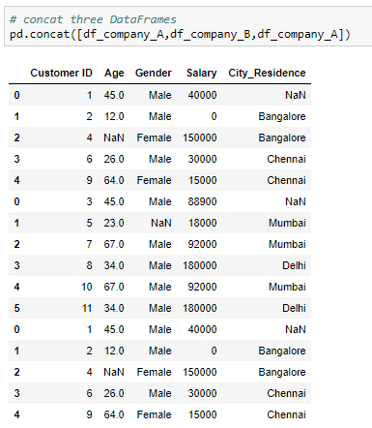
Concatenate multiple DataFrames
The concat() method can be used to concatenate more than two DataFrames simultaneously

Slide 17
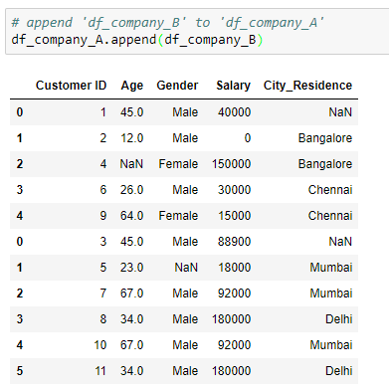
Concatenate the DataFrames
The append() method is used append a DataFrame with another
Here, we append the customers data of company ‘B’ to data of company ‘A’

Slide 18
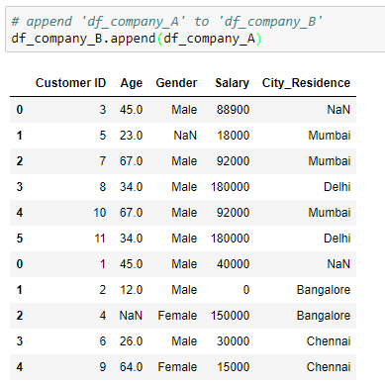
Concatenate the DataFrames
Here, we append the customers data of company ‘A’ to data of company ‘B’

Slide 19
Append vs. Concat
append() | concat()
returns the error if one tries to concatenate more than two DataFrames simultaneously | concatenates multiple DataFrames simultaneously

Slide 20
Join the DataFrames

Slide 21
Join the DataFrames
The join() method join the DataFrames based on index or key column
Index of the first DataFrame should match to one of the column in the second DataFrame

Slide 22
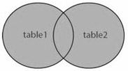
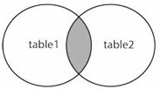
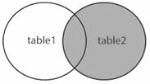
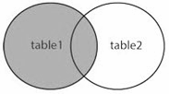
Types of join
The join types can be specified using the parameter, ‘how’
how = ‘Type’ | Description
outer | Use union of index (or column) observed in both DataFrames
inner | Use intersection of index (or column) observed in both DataFrames
right | Use only the index found in the right DataFrame
left | Use only the index (or column) found in the left DataFrame
If the type is not specified, by default it is ‘left’

Slide 23
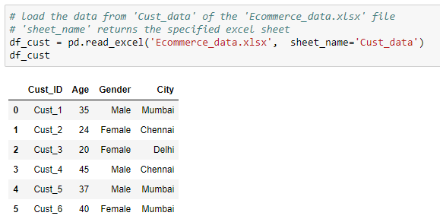
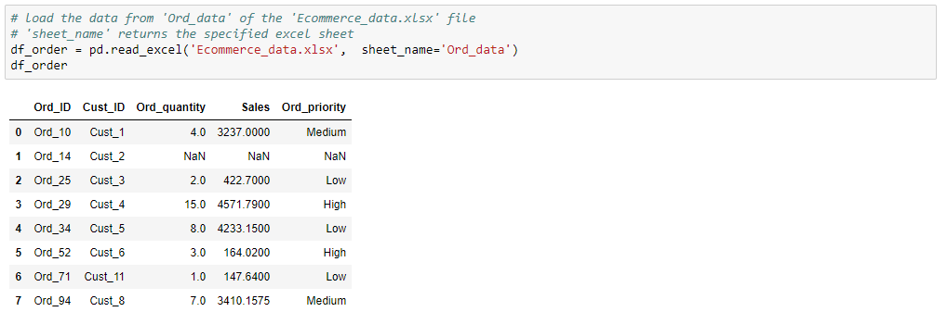
Read the DataFrames
Use the following DataFrames for further manipulations:
Customer details
Order details

Slide 24
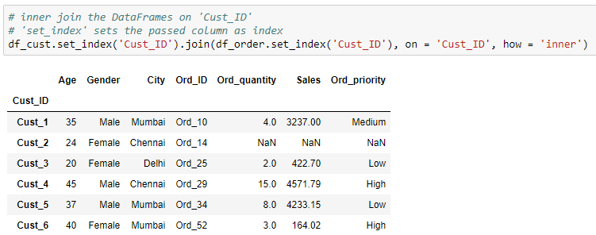
Inner Join
Join the DataFrames to get the order details along with the customer information
Merge includes the common IDs in both the DataFrames
‘Cust_ID’ as index of the new DataFrame
Merge on ‘Cust_ID’

Slide 25
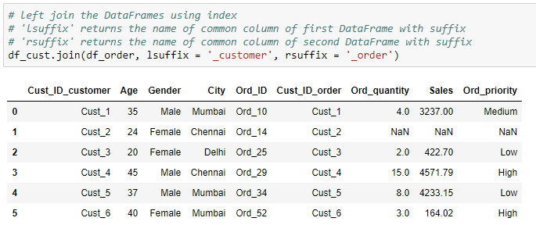
Join using index
Resultant DataFrame includes rows from both the DataFrames with same index as of ‘df_cust’
This method is useful, only if the record have same index in both the DataFrames

Slide 26
Merge the DataFrames

Slide 27
Merge the DataFrames
The merge() method concatenates the DataFrames based on one or more keys
If the column for join is not specified, the merge() method uses the overlapping column names as the keys

Slide 28
Types of merge
The merge types can be specified using the parameter, ‘how’
how = ‘Type’ | Description
outer | Use union of keys observed in both DataFrames
inner | Use intersection of keys observed in both DataFrames
right | Use only the keys found in the right DataFrame
left | Use only the keys found in the left DataFrame
If the type is not specified, by default it is ‘inner’

Slide 29
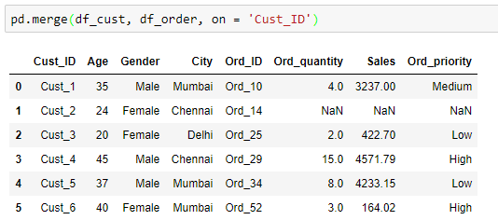
Inner merge
Merge both the DataFrames on common customer IDs
Merge on ‘Cust_ID’
Merge includes the common IDs in both the DataFrames
NaNs are printed where order details are not available

Slide 30
Read the DataFrames
Use the following DataFrames for further manipulations:
Customer details
Order details

Slide 31
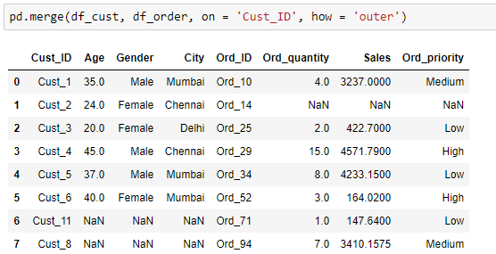
Outer merge
Merge on ‘Cust_ID’
Outer merge includes the IDs in both DataFrames
NaNs are printed where order details are not available
NaNs are printed where customer details are not available

Slide 32
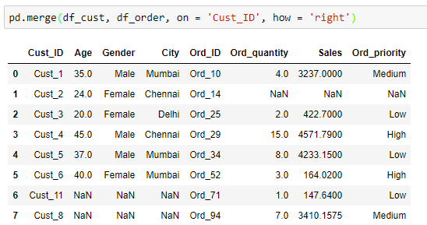
Right merge
Merge on ‘Cust_ID’
Merge includes all the IDs in ‘df_order’
NaNs are printed where order details are not available
NaNs are printed where customer details are not available

Slide 33
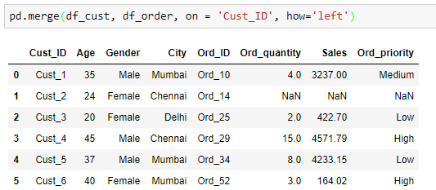
Left merge
Merge on ‘Cust_ID’
Merge includes all the IDs in ‘df_cust’
NaNs are printed where order details are not available

Slide 34
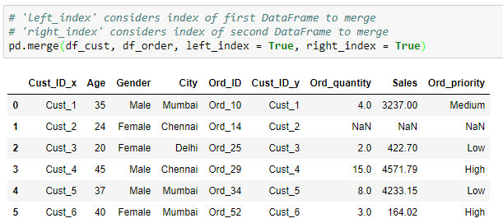
Merge using index
Merged DataFrame has the number of rows equal to that of the minimum of both the DataFrames. It includes rows from both DataFrames having same index
This method is useful, only if the record have same index in both the DataFrames

Slide 35
Merge vs. Join
Merge | Join
Joins one or more columns of the second DataFrame | Joins by the index of the second DataFrame
By default, performs ‘inner’ merge | By default, performs ‘Left’ join
Returns error if one tries to merge more than two DataFrames simultaneously | Joins multiple DataFrames by index

Slide 36
Unstack and Stack a Series

Slide 37
Create a series
Create python series as shown below:

Slide 38
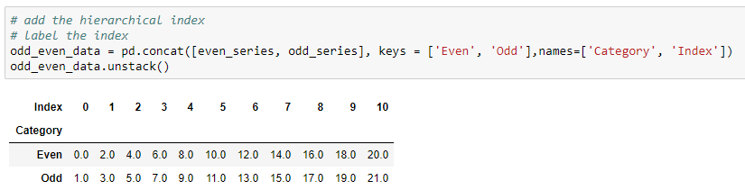
Unstack a series
Unstacking can be used to rearrange the series with hierarchical index in a DataFrame
Unstack the series at index ‘Index’

Slide 39
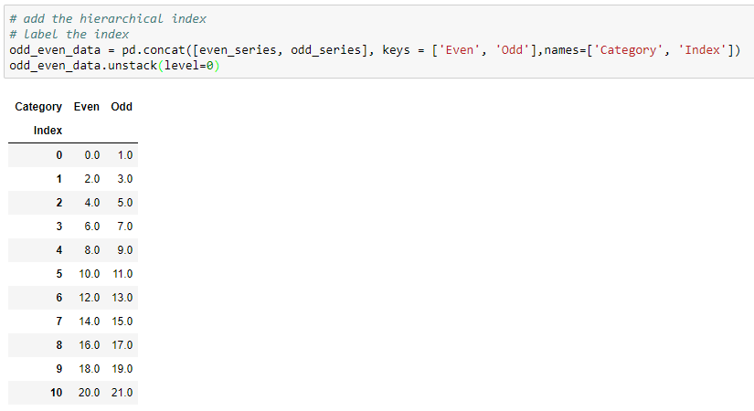
Unstack a series
We can pass the level of index to unstack the series using parameter, ‘level’
Unstack the series at index ‘Category’
By default, the unstack() method uses the last level of index (-1) to unstack the series

Slide 40
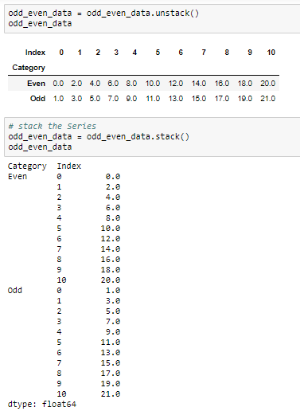
Stack a series
Stack is the inverse operation of unstack
It returns a series with hierarchical index

Slide 41
Unstack and Stack the DataFrame

Slide 42
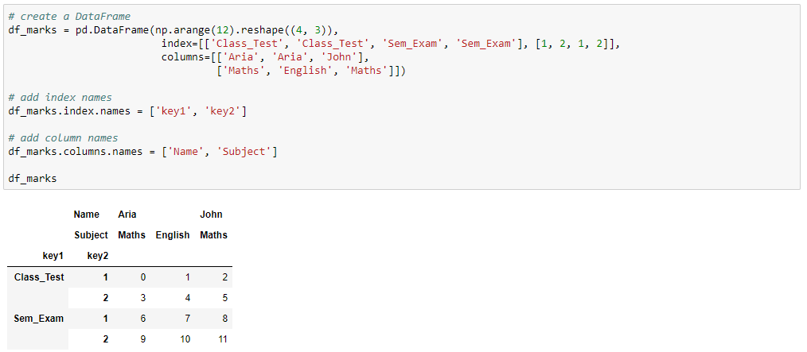
Create the DataFrame
Add the hierarchical indexes

Slide 43
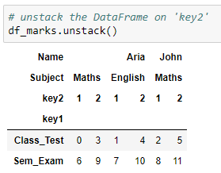
Unstack the DataFrame
Unstacking a DataFrame returns a DataFrame having a new level of column label which consists of the pivoted index label
New level of column
Unstack the DataFrame at index ‘key2’

Slide 44
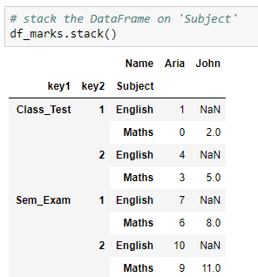
Stack the DataFrame
Stacking a DataFrame returns a DataFrame having a new level of innermost index consisting of the the pivoted column label
As the English marks for John are unknown, the NaNs are printed for corresponding observations
New level of
index

Slide 45
Reshape

Slide 46
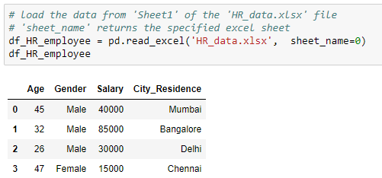
Read the DataFrames
Use the following DataFrame for further manipulations:

Slide 47
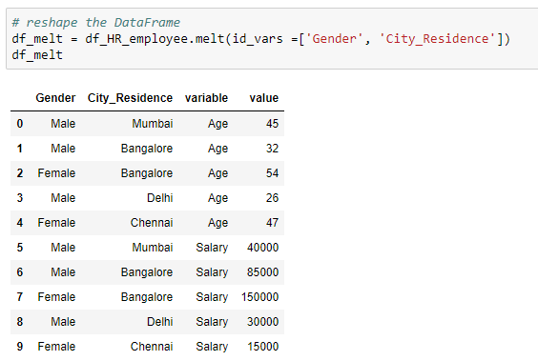
Reshape
The melt() method is used to change the DataFrame format from wide to long
The column ‘variable’ contains all the columns except the identifiers and ‘value’ contains the values of corresponding column
Pass list of columns as identifiers

Slide 48
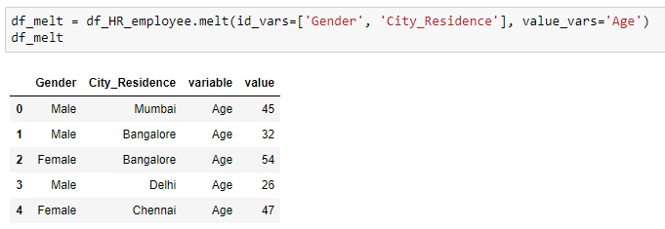
Reshape
Assign the variables to the parameter, ‘value_vars’ to get the corresponding values for specified identifiers
Pass the column names to return the corresponding values

Slide 49
Pivot Tables

Slide 50
Pivot tables
It has a DataFrame like structure
It is used to display the data for the specified columns and index

Slide 51
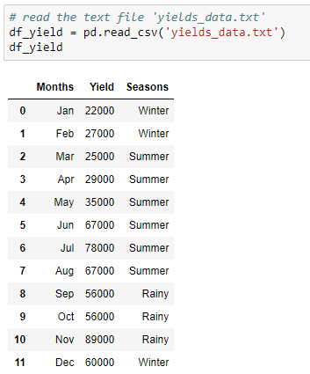
Read the DataFrame
Use the following DataFrame to create a pivot table

Slide 52
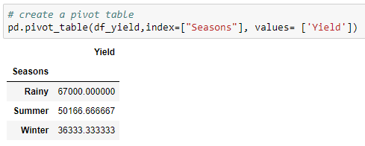
Create a pivot table
The pivot_table() method generates a pivot table for the given index
By default, the aggregate function is ‘mean’, which aggregates the columns passed in the parameter, ‘values’
Pass the columns to aggregate
Average yield per season

Slide 53
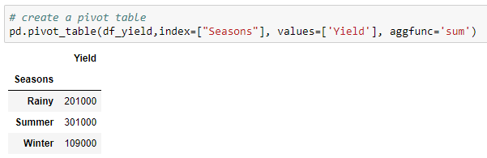
Create a pivot table
Returns the sum of values
Sum of yield per season

Slide 54
Cross Tables

Slide 55
Cross tables
Cross tables are similar to pivot tables
It computes a cross tabulation of two or more factors

Slide 56
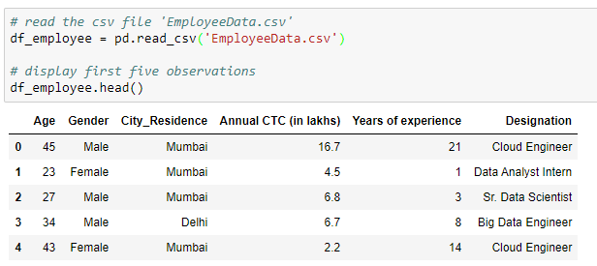
Read the DataFrame
Read the csv file ‘EmployeeData’ and print the first five observations

Slide 57
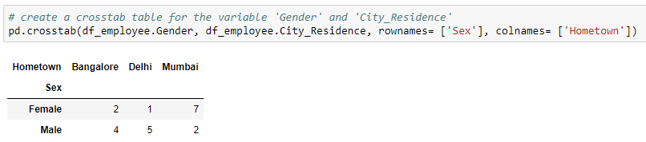
Create a cross table
Find the city-wise gender count using the crosstab() method
Add the row label
Add the column label
By default, the crosstab() method returns the frequency table of the variables

Slide 58
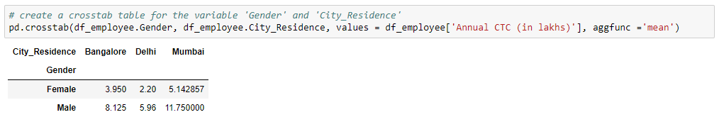
Create a cross table
Find the city-wise distribution of salary for different genders
Values to be aggregated
Function to aggregate the values
Gender and city-wise
Average salary

Slide 59
Check for duplicates

Slide 60
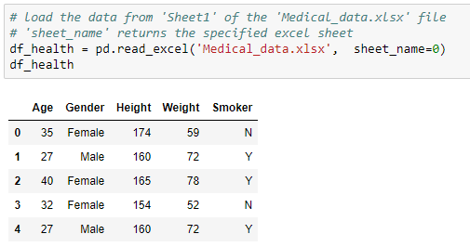
Read the DataFrames
Use the below DataFrame for further manipulations:

Slide 61
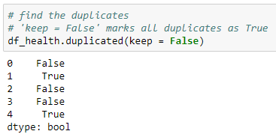
Check for duplicates
Check the duplicate observations using the duplicated() method
The second and last observation in the dataset is same

Slide 62
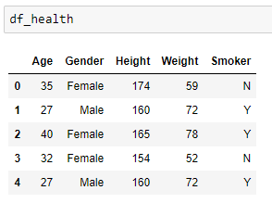
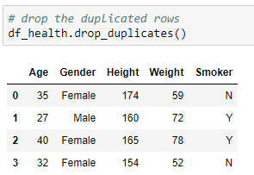
Drop duplicates
Use the drop_duplicates() method to drop the duplicated rows
Before
After

Slide 63
Dropping Rows and Columns

Slide 64
Drop the rows and columns
The drop() method is used to drop the unwanted rows and columns from the data
There are scenarios where we need to drop certain rows and/or columns which have missing values, or are redundant with respect to our analysis

Slide 65
Read the DataFrame
Read the csv file ‘EmployeeData’ and print the first five observations

Slide 66
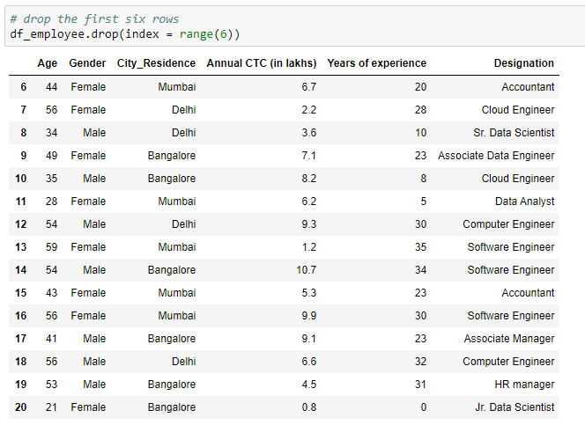
Drop the rows
Pass the row indices to ‘index’
Use drop() method to drop the rows with index values
Here ‘range(6)’ is used to drop the first six rows

Slide 67
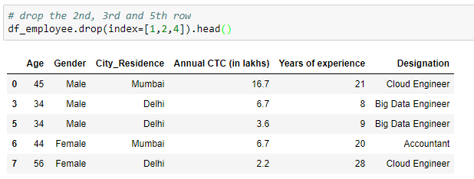
Drop the rows
Pass the list of row indices to drop the rows

Slide 68
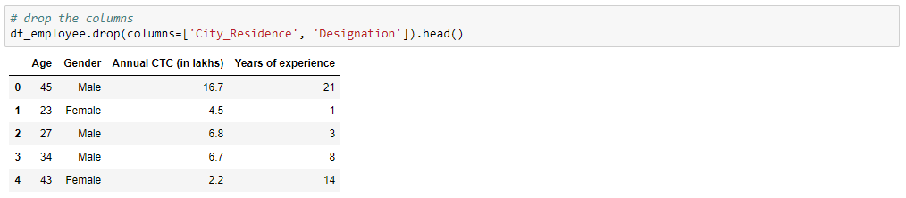
Drop the columns
Pass the list of column names to drop the columns

Slide 69
Usage of inplace
We saw how to drop the unwanted rows and column
However, doing so does not delete it permanently
To remove them permanently from the data, we use the parameter ‘inplace’ and set it to true
By default, the value inplace takes is false

Slide 70
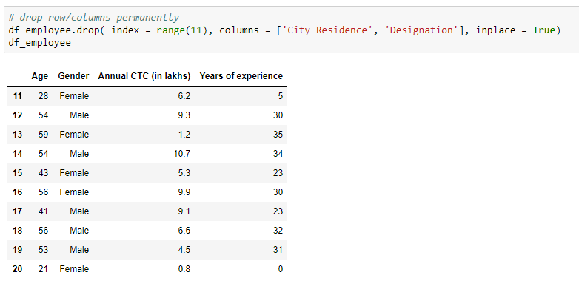
Usage of inplace
Drop the the first 11 rows and the variables ‘City_Residence’ and ‘Designation’
Removes the rows and columns from the original data

Slide 71
Mapping and Replacing

Slide 72
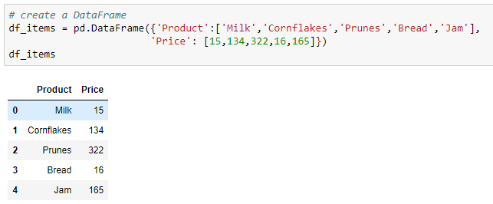
Create a DataFrame
Use the below DataFrame for further manipulations:

Slide 73

Map the dictionary
Use the map() method to create a new column by mapping the DataFrame column values with the dictionary key
Map the dictionary to create a new column

Slide 74

Replace the values
The replace() method is used to replace the values in the DataFrame
Create a dictionary to replace the values

Slide 75
Group the DataFrame

Slide 76
Create a DataFrame
Use the following DataFrame for further manipulations:

Slide 77

Group the DataFrame
Use groupby() method to group the dataframe by the specific column(s)
Converts the series to DataFrame
Group the data by ‘Seasons’
Add the values for each season

Slide 78

Group the DataFrame
Get the number of months for each season
Returns the number of months per season
Output as a series

Slide 79
Summary Statistics

Slide 80
Read the DataFrame
Read the csv file ‘EmployeeData’ and print the first five observations

Slide 81

Summary statistics
The info() returns the information about the type of the object, shape, number of non-null entries in each variable, and the data type
Returns the number of columns for each data type

Slide 82
Summary statistics
Summary Statistics of the DataFrame is obtained using the describe() method
By default, it returns the summary of the numeric variables
Summary Statistics of the categorical (object) variables is obtained using the .describe(include =['object'])

Slide 83

Summary statistics of numerical variables
count | Total number of observations
mean | Average value
std | Standard deviation
min | Minimum value
25% | First quartile
50% | Second quartile (median)
75% | Third quartile
max | Maximum value

Slide 84

Summary statistics of categorical variables
count | Total number of observations
unique | Number of unique categories
top | Category with highest frequency
freq | Frequency of the ‘top’ value

Slide 85
Skewness and Kurtosis

Slide 86
Read the DataFrame
Read the csv file ‘EmployeeData’ and print the first five observations

Slide 87
Skewness
Skewness is a lack of symmetry or departure from symmetry
If the distribution of the data is elongated on either sides then the data is said to be skewed
If the distribution of the data is elongated on the left side then the data is said to be left skewed
If the distribution of the data is elongated on the right side then the data is said to be right skewed

Slide 88

Skewness
Returns the skewness
Skewness of the numeric variables
Skewness value | Interpretation
= 0 | No skewness
> 0 | Positive skewness
< 0 | Negative skewness

Slide 89
Kurtosis
It is a statistical measure that defines how heavily the tails of the distribution differ from the normal distribution
It identifies whether the tails of a given distribution contain extreme values
Thicker the tails are more the extreme values in the data

Slide 90

Kurtosis
Returns the kurtosis
Kurtosis of the numeric variables
Kurtosis value | Interpretation
= 0 | Mesokurtic distribution
> 0 | Leptokurtic distribution
< 0 | Platykurtic distribution

Slide 91
Thank You

